Slide 1
Model Performance and Feature Importance Analysis
Final Model Performance Model: Gradient Boosting Regressor Mean Absolute Error (MAE): 0.1634 R-squared (R²): 0.2759 Interpretation:
The model's average prediction error is approximately 16.34%.
The model explains about 27.59% of the variance in stock levels, indicating it captures some of the patterns but also has room for improvement.

Slide 2
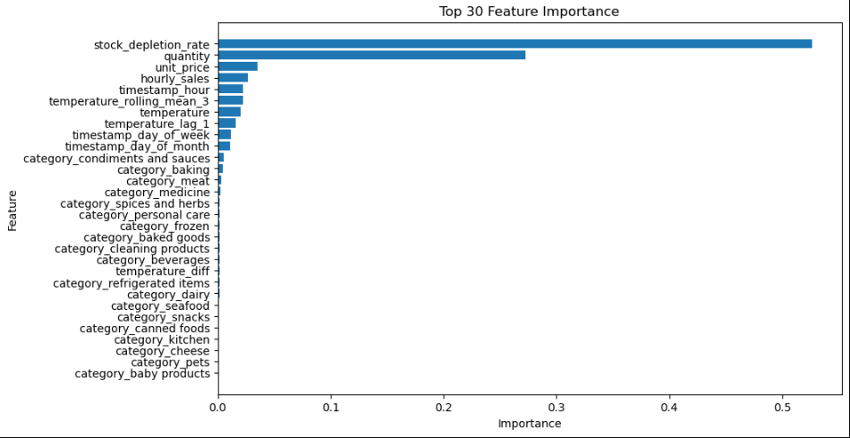
Model Performance and Feature Importance Analysis
Notes:
Feature importance plot

Slide 3
Model Performance and Feature Importance Analysis
Feature Importance Analysis The top 10 most important features that influence stock level predictions are as follows:
1. Stock Depletion Rate: 52.63% 2. Quantity: 27.27% 3. Unit Price: 3.54% 4. Hourly Sales: 2.63% 5. Timestamp Hour: 2.25% 6. Temperature Rolling Mean (3 hours): 2.22% 7. Temperature: 2.04% 8. Temperature Lag (1 hour): 1.61% 9. Timestamp Day of Week: 1.17% 10. Timestamp Day of Month: 1.11%

Slide 4
Model Performance and Feature Importance Analysis
Analysis: - Stock Depletion Rate is the most significant predictor, accounting for more than half of the model's decisions. - Features related to quantity, pricing, and hourly sales are also critical, indicating the model leverages sales and inventory data effectively. - Temporal features like time of day and day of the week provide valuable context for predicting stock levels. - Temperature-related features suggest environmental conditions in storage areas are moderately important. Conclusion: - The Gradient Boosting Regressor shows promise in predicting stock levels with reasonable accuracy. - The importance of the stock depletion rate and sales data underscores the value of real-time monitoring and historical sales trends in inventory management. - Continuous improvement through feature engineering and model tuning can enhance predictive performance.

